Slide 2
CONNECTING CHILDHOOD TRAUMA AND DELINQUENCY
BRIDGE OVER TROUBLED WATER

Slide 3
When you're weary Feeling small When tears are in your eyes I will dry them all I'm on your side Oh, when times get rough And friends just can't be found Like a bridge over troubled water I will lay me down Like a bridge over troubled water I will lay me down When you're down and out When you're on the street When evening falls so hard I will comfort you I'll take your part Oh, when darkness comes And pain is all around Like a bridge over troubled water I will lay me down
Like a bridge over troubled water I will lay me down
Sail on, silver girl Sail on by Your time has come to shine All your dreams are on their way See how they shine Oh, if you need a friend I'm sailing right behind Like a bridge over troubled water I will ease your mind Like a bridge over troubled water I will ease your mind

Slide 4
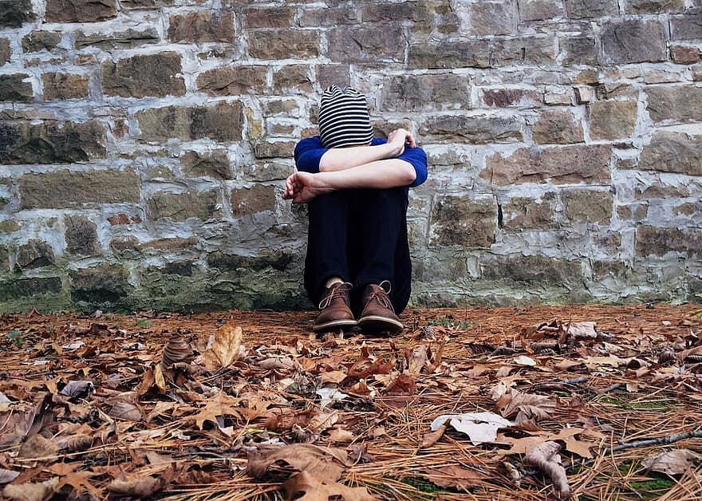
According to the United States Department of Archives, children exposed to violence are –
more likely to abuse drugs and alcohol;
suffer from depression, anxiety, and post-traumatic disorders;
fail or have difficulty in school;
and become delinquent and engage in criminal behavior (Finkelhor et al., 2017).

Slide 5
ACE: ADVERSE CHILDHOOD EXPERIENCES
= TRAUMA UNADDRESSED TRAUMA
DIRTY PAIN NEGATIVE BEHAVIOR
Adverse child­hood expe­ri­ences (ACEs) refer to poten­tial­ly trau­mat­ic events and cir­cum­stances that impair an individual’s sense of safe­ty and sta­bil­i­ty dur­ing child­hood (0 – 17 years).
These expe­ri­ences may include:
abuse (phys­i­cal, emo­tion­al, or sex­u­al),
wit­ness­ing vio­lence with­in the fam­i­ly or com­mu­ni­ty,
house­hold insta­bil­i­ty (incar­cer­a­tion of fam­i­ly mem­bers, parental sep­a­ra­tion, sub­stance use or men­tal health prob­lems).
Articles of Interest: Adverse Childhood Experiences, Their Effects on Mental Health, and the Connection to Legal System Involvement | Death Penalty Information Center

Slide 7
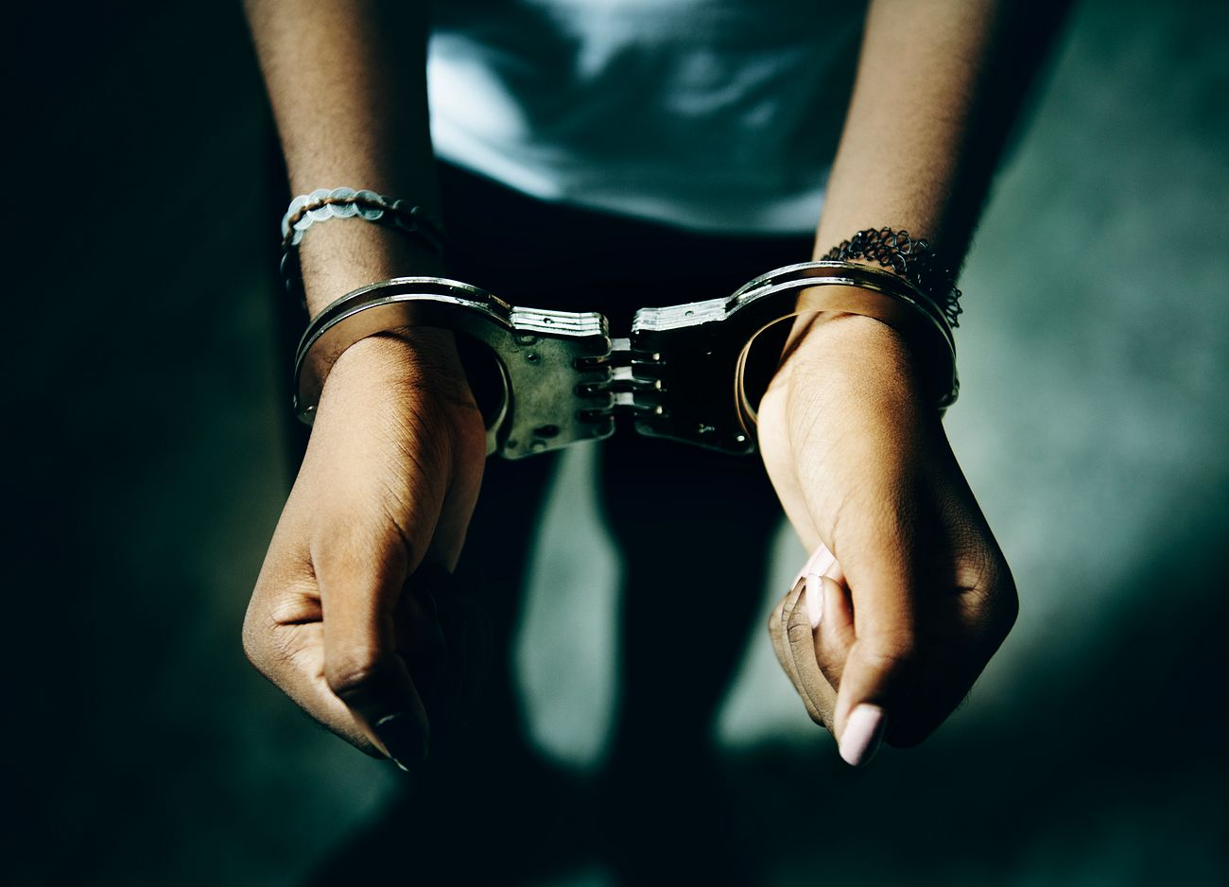
Research also indi­cates that expo­sure to ACEs increas­es an individual’s like­li­hood of criminal activity.
This phe­nom­e­non is a grow­ing con­cern in pol­i­cy con­ver­sa­tions and psy­cho­log­i­cal research because of the life­time impact of ACEs on neu­ro­log­i­cal devel­op­ment, man­i­fest­ing in the preva­lence of var­i­ous neg­a­tive men­tal health out­comes.

Slide 8
The lack of knowledge and treatment for trauma increases recidivism rates for juvenile delinquents. This results in additional costs for families and the judicial system. Schools do not have many resources that focus on at-risk youth, which negatively affects these youths’ academic performance and achievements.
Furthermore, trauma-related symptoms that go undiagnosed can lead to antisocial behavior disorders and substance abuse. Focusing on the immediate problem of delinquent behavior, rather than on a solution, such as trauma treatment, results in our youth growing into adult criminals. Eaton, Booke (2020) The Relationship Between Trauma and Juvenile Delinquency

Slide 9
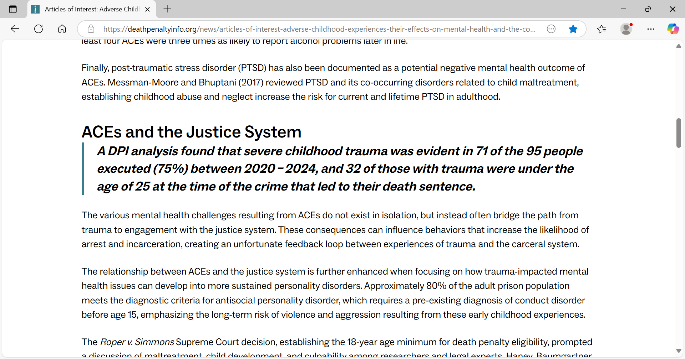
Articles of Interest: Adverse Childhood Experiences, Their Effects on Mental Health, and the Connection to Legal System Involvement | Death Penalty Information Center

Slide 10
The Kids Are Not All Right: How Trauma Affects Development - Focus for Health

Slide 11
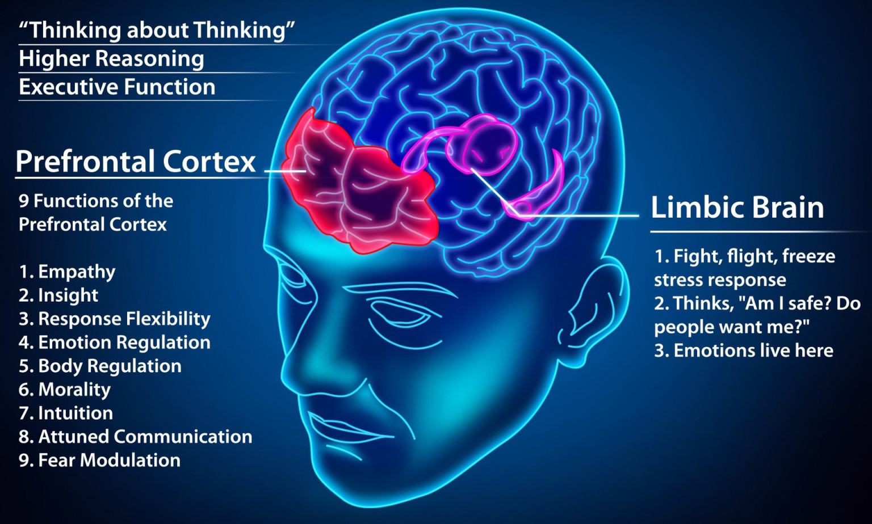
The National Institute of Mental Health reports that specific cognition and mood symptoms of posttraumatic stress disorder include negative thoughts about oneself or the world, distorted feelings like guilt or blame, and a loss of interest in enjoyable activities (2019). These symptoms of posttraumatic stress disorder caused by trauma can be confused with delinquent behavior. Eaton, Booke (2020) The Relationship Between Trauma and Juvenile Delinquency

Slide 12
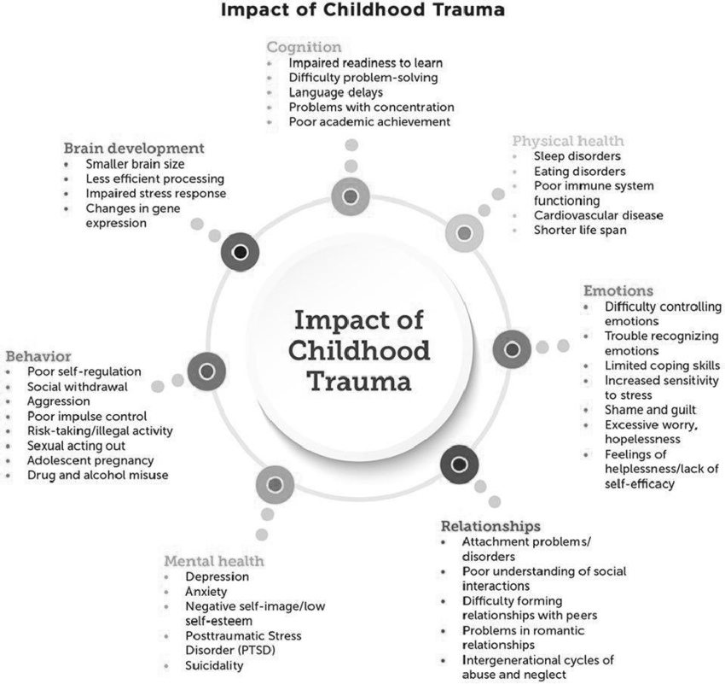

Slide 13
SELDOMLY-ADDRESSED: RACIALIZED TRAUMA
Suggested for group book study
The Kids Are Not All Right: How Trauma Affects Development https://www.focusforhealth.org/kids-are-not-alright-how-trauma-affects-development/
The Rage of Innocence: How America Criminalizes Black Youth, Henning
Between the World and Me, Coates
My Grandmother’s Hands, Menakem
Post Traumatic Slave Syndrome, DeGruy
The Guide to Black Mental Health, Walker
Juvenile and Family Division Annual Report 2023.pdf

Slide 14
According to the Childhood Trauma Model, the impact of trauma is pronounced for Black youth because of systemic racism.
Further, Black youth were nearly twice as likely to be arrested for a violent felony as White youth (Johnson, 2018, p. 1450). Latina/o and White youth who experienced trauma were no more or less likely to be violent felons than those who did not experience trauma.

Slide 15
Johnson’s 2018 study found that exposure to childhood trauma is linked to violent felony arrests and the risks are elevated for Black children. “The likelihood of violent felony arrest increased by 11% for each additional trauma experience (p. 1449).”
Youth who experienced three or more types of trauma were 1.7 to 3 times as likely to have violent felony arrests.
Johnson, M.E. (2018). Trauma, Race, and Risk for Violent Felony Arrests Among Florida Juvenile Offenders. Crime & Delinquency, 64(11), pp. 1437-1457

Slide 16
“The intersection of gender and class hinders access to appropriate resources that buffer the impact of trauma. This can expose Black youth to more risk factors. Society often prescribes felony convictions for children’s symptoms of trauma-induced distress and is more likely to do so when the child is Black. The disparity represents inequalities across schools, health care institutions, and the juvenile justice system to provide treatment and basic services to Black children” (Johnson, 2018, p. 1451).

Slide 17
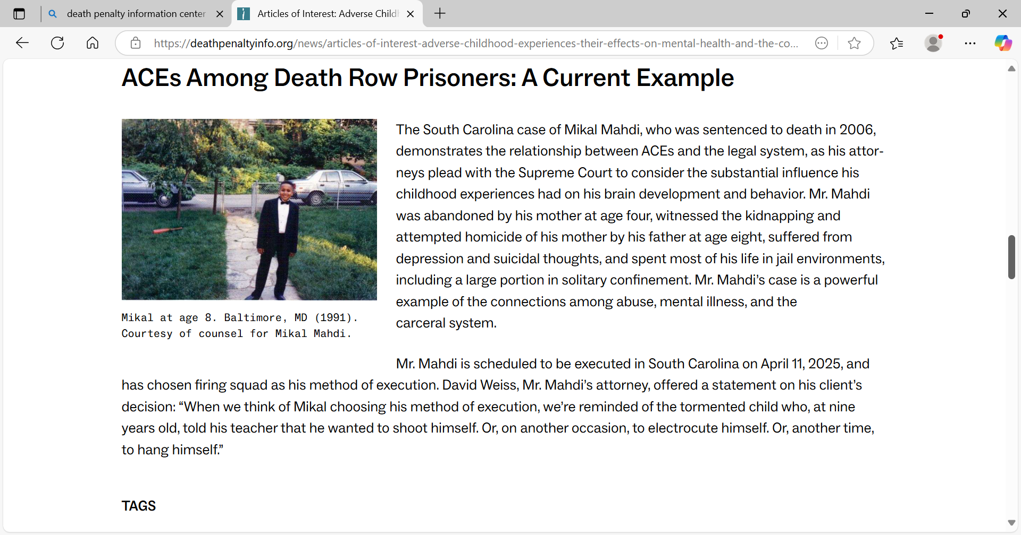

Slide 18
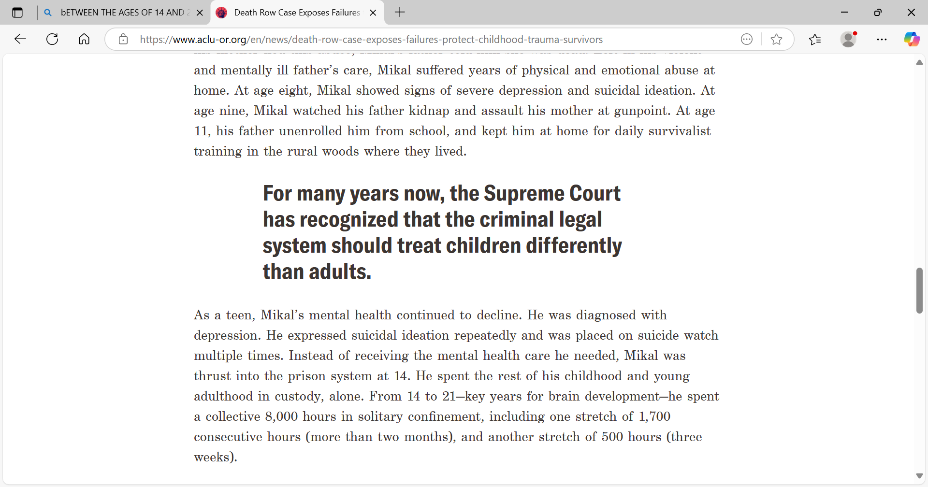
Death Row Case Exposes Failures to Protect Childhood Trauma Survivors
Mikal Mahdi’s life was marked by abuse. Today, as he awaits execution, the courts have the responsibility to acknowledge the systemic failures that shaped his path. April 8, 2025 - 3:00pm
Today, at 42, Mikal is remorseful and accepts responsibility for crimes he committed when he was 21. He has been denied life without parole, and the state intends to execute him Friday, April 11th. His traumatic childhood, at home and in custody, shaped his life and actions and should have been a key factor in the state’s decision, yet his trauma was not considered. It is a profound injustice that, today, the system that has consistently failed Mikal at every turn now ignores those failures when determining whether he should live or die.
Death Row Case Exposes Failures to Protect Childhood Trauma Survivors | ACLU of Oregon

Slide 19
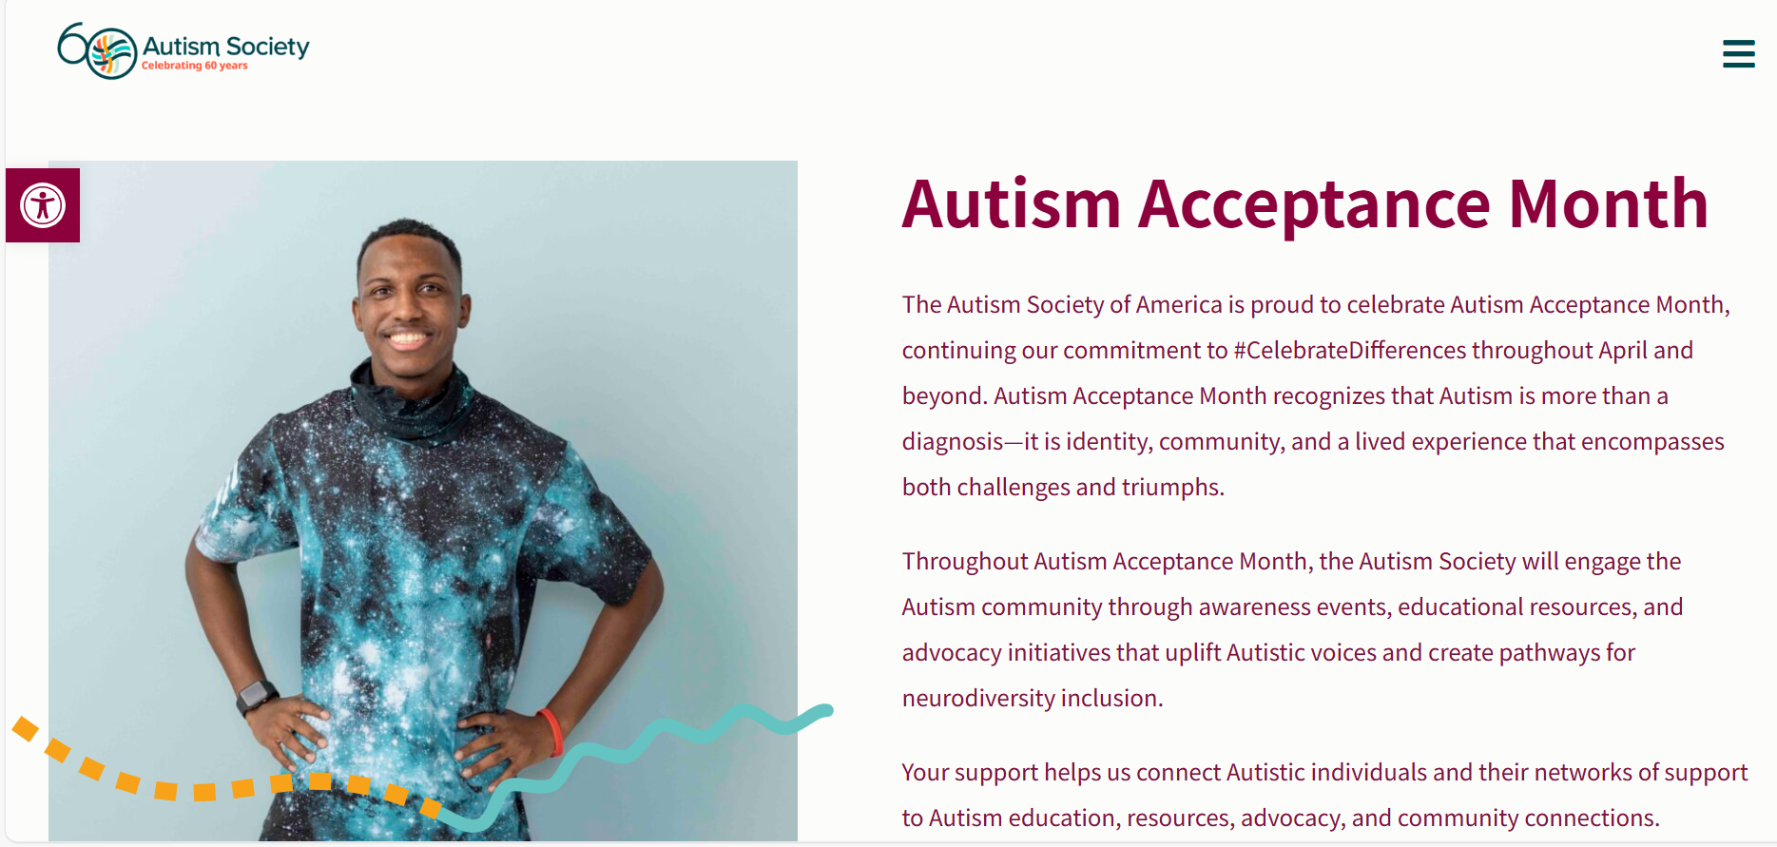
FYI: AN MJJA SALUTE - APRIL IS AUTISM ACCEPTANCE MONTH
ANOTHER FORM OF POSSIBLE TRAUMA?
1 in 44 children are diagnosed with autism spectrum disorder
https://autismsociety.org/autism-acceptance-month/

Slide 20
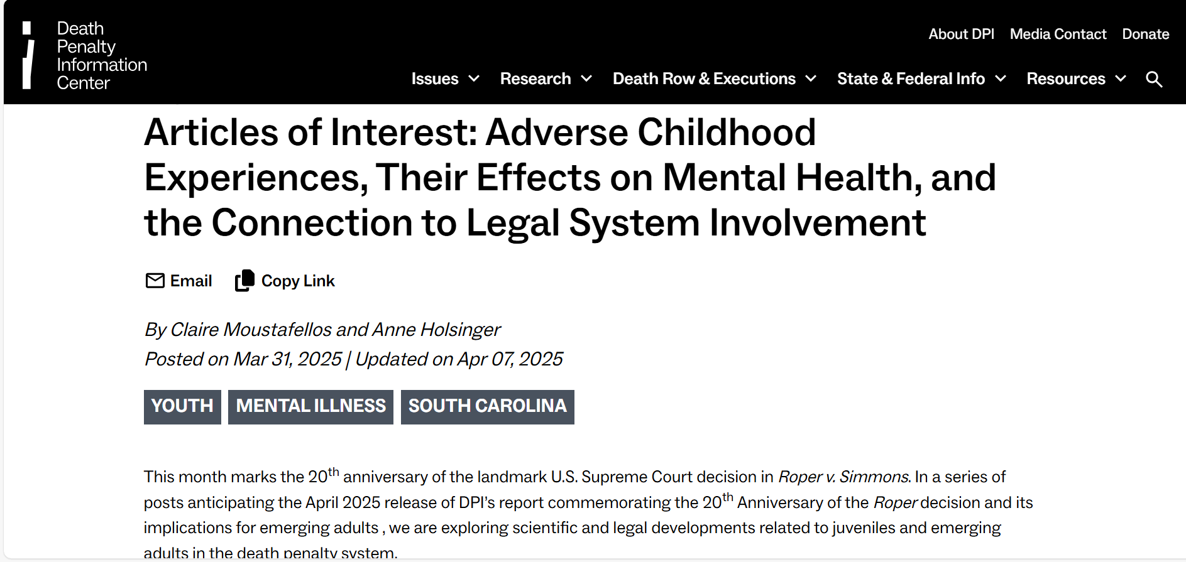
FYI: Articles of Interest: Adverse Childhood Experiences, Their Effects on Mental Health, and the Connection to Legal System Involvement | Death Penalty Information Center

Slide 21
About TRAUMA, RESISTANCE, AND RESILIENCE
The nervous system reacts to persistent stresses of oppressive systems.
Burnout repetition of any and/or all responses with no results.
Fight response to protest, etc.
Flee – distance self
Freeze – want to say or do something but can’t seem to mobilize
Flock – connect with like others
Fawn – appease and seek to comfort others

Slide 22
Generational Trauma - trauma that is not only experienced by one person, but extends from one generation to the next. It can be caused by various factors –
War
Adverse Poverty / Famine
Natural Disasters
Social or political persecution, including police profiling, surveillance
Slavery
Racism
Genocide
Anti-Semitism
Child Abuse
Neglect
Alcoholism
Accidents

Slide 23
Generational Trauma
It can be inherited genetically through epigenetic inheritance or learned through behaviors, thought patterns, nuances, and ways of being that are taught or implied from an early age. It can influence how future generations cope with, view, and handle traumatic events. It can be silent, covert, undefined, or considered normal by those who experience it. It can affect the psychological well-being of a group of people or a family.
See, also Race-Based Traumatic Stress: A unique psychological distress that Black, Indigenous and People of Color (BIPOC) suffer as a result of racism and discrimination.

Slide 24
https://www.sportskeeda.com/stories/subtle-symptoms-of-generational-trauma/#

Slide 25
https://www.sportskeeda.com/stories/subtle-symptoms-of-generational-trauma/#

Slide 26
https://www.sportskeeda.com/stories/subtle-symptoms-of-generational-trauma/#

Slide 27
Trauma-Informed Schools Initiative | Missouri Department of Elementary and Secondary Education (mo.gov)

Slide 28
Trauma-Informed Schools Initiative | Missouri Department of Elementary and Secondary Education (mo.gov)

Slide 33
FYI: George Stinney’s Conviction Tossed Out … 70 Years After Execution - The New York Times
Seventy years after he was executed in South Carolina, George Stinney’s conviction was vacated by a state judge Wednesday on the grounds that he had not received a fair trial. Stinney, a 14-year-old black boy, was arrested in March 1944 for the murder of two white girls in Clarendon County, S.C. In less than three months, he was tried, convicted and put to death.

